Slide 1
Chapter 9 Crash Recovery
9.1 Crash Recovery
9.2 Failure Classification
9.3 Storage Structure
9.4 Recovery and Atomicity
9.5 Log Based Recovery
9.6 Checkpoints
9.7 Shadow paging
9.8 Data Backup / Recovery
9.9 Remote Backup System

Slide 2
9.1 Crash Recovery
DBMS is a highly complex system with hundreds of transactions being executed every second.
The durability and robustness of a DBMS depends on its complex architecture and its underlying hardware and system software.
If it fails or crashes amid transactions, it is expected that the system would follow some sort of algorithm or techniques to recover lost data.

Slide 3
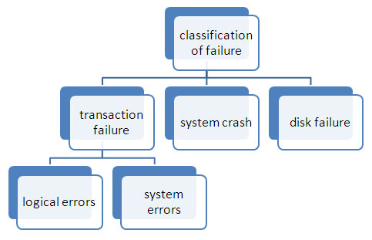
9.2 Failure classification

Slide 4
9.2 Failure classification
1) Transaction Failure
a. The transaction cannot continue because of internal conditions like data mismatch, overflow etc. this is logical error.
b. The transaction cannot continue as the system enter into an undesirable state like deadlock , this is system error
2) System crash
a. It is the failure caused due to hardware malfunctioning or software bugs that do not affect data of nonvolatile storage.

Slide 5
9.2 Failure classification
3) Disk failure
a. It is the failure caused due to head crash or data transfer failure.
b. Multiple backups are used to recover from this failure.

Slide 6
9.3 Storage Structure
Volatile storage −
As the name suggests, a volatile storage cannot survive system crashes.
Volatile storage devices are placed very close to the CPU; normally they are embedded onto the chipset itself.
For example, main memory and cache memory are examples of volatile storage.
They are fast but can store only a small amount of information.

Slide 7
9.3 Storage Structure
Non-volatile storage −
These memories are made to survive system crashes.
They are huge in data storage capacity, but slower in accessibility.
Examples may include hard-disks, magnetic tapes, flash memory, and non-volatile (battery backed up) RAM.

Slide 8
9.3 Storage Structure
Stable Memory -
This is said to be third form of memory structure but it is same as non volatile memory.
In this case, copies of same non volatile memories are stored at different places.
This is because, in case of any crash and data loss, data can be recovered from other copies.
This is even helpful if there one of non-volatile memory is lost due to fire or flood.
It can be recovered from other network location.

Slide 9
9.4 Recovery and Atomicity
When a system crashes, it may have several transactions being executed and various files opened for them to modify the data items.
Transactions are made of various operations, which are atomic in nature.
But according to ACID properties of DBMS, atomicity of transactions as a whole must be maintained, that is, either all the operations are executed or none.

Slide 10
9.4 Recovery and Atomicity
When a DBMS recovers from a crash, it should maintain the following :
It should check the states of all the transactions, which were being executed.
A transaction may be in the middle of some operation; the DBMS must ensure the atomicity of the transaction in this case.
It should check whether the transaction can be completed now or it needs to be rolled back.
No transactions would be allowed to leave the DBMS in an inconsistent state.

Slide 11
9.4 Recovery and Atomicity
There are two types of techniques, which can help a DBMS in recovering as well as maintaining the atomicity of a transaction −
Maintaining the logs of each transaction, and writing them onto some stable storage before actually modifying the database.
Maintaining shadow paging, where the changes are done on a volatile memory, and later, the actual database is updated.

Slide 12
9.5 Log Based Recovery
Log is a sequence of records, which maintains the records of actions performed by a transaction.
It is important that the logs are written prior to the actual modification and stored on a stable storage media, which is failsafe.

Slide 13
9.5 Log Based Recovery
Log-based recovery works as follows −
The log file is kept on a stable storage media.
When a transaction enters the system and starts execution, it writes a log about it.
<Tn, Start>
When the transaction modifies an item X, it write logs as follows −
<Tn, X, V1, V2>
It reads Tn has changed the value of X, from V1 to V2.
When the transaction finishes, it logs −
<Tn, commit>

Slide 14
9.5 Log Based Recovery
The database can be modified using two approaches −
Deferred database modification − All logs are written on to the stable storage and the database is updated when a transaction commits.
Immediate database modification − Each log follows an actual database modification. That is, the database is modified immediately after every operation.

Slide 15
9.5 Log Based Recovery
Deferred database modification −
It is also called NO-UNDO/REDO technique.
It is used for the recovery of the transaction failures which occur due to power, memory or OS failures.
Whenever any transaction is executed, the updates are not made immediately to the database.

Slide 16
9.5 Log Based Recovery
Deferred database modification −
They are first recorded on the log file and then those changes are applied once commit is done.
This is called “Re-doing” process. Once the rollback is done none of the changes are applied to the database and the changes in the log file are also discarded.
If commit is done before crashing of the system, then after restarting of the system the changes that have been recorded in the log file are thus applied to the database.

Slide 17
9.5 Log Based Recovery
Immediate database modification −
It is also called UNDO/NO-REDO technique.
It is used for the recovery of the transaction failures which occur due to power, memory or OS failures.
Whenever any transaction is executed, the updates are made directly to the database and the log file is also maintained which contains both old and new values.
Once commit is done, all the changes get stored permanently into the database and records in log file are thus discarded.

Slide 18
9.5 Log Based Recovery
Immediate database modification −
Once rollback is done the old values get restored in the database and all the changes made to the database are also discarded.
This is called “Un-doing” process.
If commit is done before crashing of the system, then after restarting of the system the changes are stored permanently in the database.

Slide 19
Assignment
Difference between deferred update and immediate update

Slide 20
9.6 Checkpoints
The checkpoint is a type of mechanism where all the previous logs are removed from the system and permanently stored in the storage disk.
The checkpoint is like a bookmark. While the execution of the transaction, such checkpoints are marked, and the transaction is executed then using the steps of the transaction, the log files will be created.
When it reaches to the checkpoint, then the transaction will be updated into the database, and till that point, the entire log file will be removed from the file. Then the log file is updated with the new step of transaction till next checkpoint and so on.
The checkpoint is used to declare a point before which the DBMS was in the consistent state, and all transactions were committed.

Slide 21
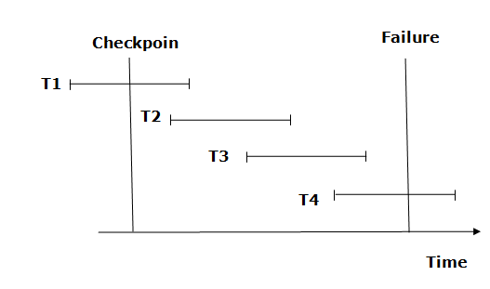
9.6.1 Recovery using Checkpoints
The recovery system reads log files from the end to start. It reads log files from T4 to T1.
Recovery system maintains two lists, a redo-list, and an undo-list.

Slide 22
9.6.1 Recovery using Checkpoints
The transaction is put into redo state if the recovery system sees a log with <Tn, Start> and <Tn, Commit> or just <Tn, Commit>. In the redo-list and their previous list, all the transactions are removed and then redone before saving their logs.
For example: In the log file, transaction T2 and T3 will have <Tn, Start> and <Tn, Commit>. The T1 transaction will have only <Tn, commit> in the log file. That's why the transaction is committed after the checkpoint is crossed. Hence it puts T1, T2 and T3 transaction into redo list.

Slide 23
9.6.1 Recovery using Checkpoints
The transaction is put into undo state if the recovery system sees a log with <Tn, Start> but no commit or abort log found. In the undo-list, all the transactions are undone, and their logs are removed.
For example: Transaction T4 will have <Tn, Start>. So T4 will be put into undo list since this transaction is not yet complete and failed amid.

Slide 24
9.7 Shadow Paging
Shadow Paging is recovery technique that is used to recover database.
In this recovery technique, database is considered as made up of fixed size of logical units of storage which are referred as pages.
pages are mapped into physical blocks of storage, with help of the page table which allow one entry for each logical page of database.
This method uses two page tables named current page table and shadow page table.

Slide 25
9.7 Shadow Paging
The entries which are present in current page table are used to point to most recent database pages on disk.
Another table i.e., Shadow page table is used when the transaction starts which is copying current page table.
After this, shadow page table gets saved on disk and current page table is going to be used for transaction.
Entries present in current page table may be changed during execution but in shadow page table it never get changed.
After transaction, both tables become identical.

Slide 26
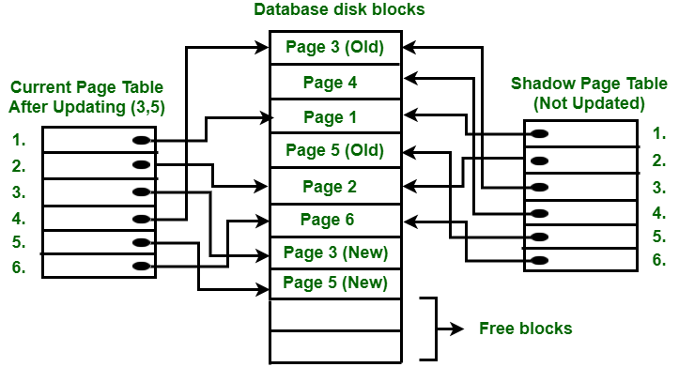
9.7.1 Working of Shadow Paging
This technique is also known as Cut-of-Place updating.

Slide 27
9.7.1 Working of Shadow Paging
All the read and write transactions are performed on the shadow copy of the database.
When the transactions get completed, then the results will be updated to the database.
If any transaction fails during the execution it will not be updated in the database because read and write operations are firstly performed on the shadow copy of the database.
The database is only updated when the transaction is successfully completed.

Slide 28
9.7.2 Directories in Shadow Paging
Current Directory or Current page table
At the start of the transaction, both the directories (current and shadow) are identical and the current directory of a database is updated when the transaction performs a write operation.
The current directory is also called a current page table. The most recent pages of the database are stored in the current page table.
.

Slide 29
9.7.2 Directories in Shadow Paging
Shadow Directory or Shadow page table
In this technique, a copy of a database is created that is called a shadow directory.
The shadow directory is never changed during the execution of a transaction. It is also called the shadow page table.

Slide 30
Assignment
Advantages and Disadvantages of shadow paging

Slide 31
9.8 Data Backup / Recovery
Database Backup is storage of data that means the copy of the data.
It is a safeguard against unexpected data loss and application errors.
It protects the database against data loss.
If the original data is lost, then using the backup it can reconstructed.

Slide 32
9.8.1 Methods of Backup
Full Backup - This method takes a lot of time as the full copy of the database is made including the data and the transaction records.
Transaction Log - Only the transaction logs are saved as the backup in this method. To keep the backup file as small as possible, the previous transaction log details are deleted once a new backup record is made.
Differential Backup - This is similar to full backup in that it stores both the data and the transaction records. However only that information is saved in the backup that has changed since the last full backup. Because of this, differential backup leads to smaller files.

Slide 33
9.8.2 Database Recovery
Log based recovery - In log based recovery, logs of all database transactions are stored in a secure area so that in case of a system failure, the database can recover the data.
Shadow paging - In shadow paging, after the transaction is completed its data is automatically stored for safekeeping.

Slide 34
9.9 Remote Backup System
Remote backup provides a sense of security in case the primary location where the database is located gets destroyed.
Remote backup can be offline or real-time or online.
In case it is offline, it is maintained manually.

Slide 35
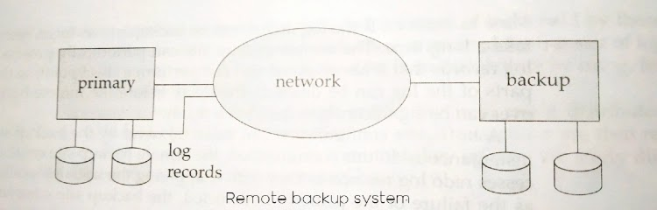
9.9 Remote Backup System

Slide 36
This is the end of the lecture!
I hope you enjoyed it.
Thank You

